Slide 1
Target Hardening 4 D’s of CRIME PREVENTION
Deny access
Delay the act
Detect the crime
Deter the attack

Slide 2
Target Hardening 4 D’s of CRIME PREVENTION
The National Crime Prevention Institute (NCPI) teaches a theory of prevention call the Four D’s as follows:
Deny – the use or access to the criminal.
Delay – methods used to slow down the criminal.
Detect – the bad guys before or after the crime has been committed.
Deter – the criminal from choosing one victim in favor of another.

Slide 3
Target Hardening
The next few slides will give you more information on target hardening your property. This includes door and window locks, signage used on the property and security lighting basics.

Slide 4
Target Hardening Safety vs. Security

Slide 5
Safety vs. Security
Safer because you have a gated community?
Not necessarily!
Security is a bout technical measures, like the strength of the locks on your doors and windows.
Safety is about the likelihood that you’ll actually suffer from some sort of attack.
Security measures like locking doors and windows, not leaving valuables in plain view etc. must be followed by your residents to help deter criminal activity.

Slide 6
Target Hardening Security devices

Slide 7
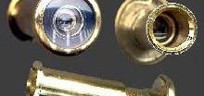
Exterior doors
Solid core wood or metal.
They are much harder to kick open.
180 degree eye viewers
in all entry doors.
Optional: Extra viewer at eye level
for children or handicap.
Hinge pins required for exterior
hinges. (Storage room doors)

Slide 8
Doors & Locks (dead bolts)
Single cylinder metal dead
bolts on all single entry doors
(with a 1 inch-throw)
1”
Anti-wrench collar throw
Anti-
wrench
collar

Slide 9
Doors & Locks (strike plate)
Security strike plates are
recommended on all entry
doors (4-screws)
2 inch minimum length screws
are required in strike plates.
Where construction permits
and not required for metal
frames.
2 inch minimum length screws

Slide 10
Doors & Locks
If doors and locks are
broken, the door is not
secure.
Replace damaged
door or lock as soon as
possible for the safety
of the resident.

Slide 11
Windows
Windows are left unlocked more
often than doors are.
Remind residents to keep windows
closed and locked!
There are many ways to secure
windows depending on the type.
Consult with your maintenance staff for
the best way to secure the
windows in your community.

Slide 12
Windows Some ways to secure them: Lift & Slide Protection
Thumbscrew locks or Wooden dowels
placed In the track.
Use pins or screws to prevent lifting.

Slide 13
Arcadia/Sliding Glass Doors
Even when latched, the door can
still be lifted out of the track.
This technique allows the door lock
to be lifted up and out.

Slide 14
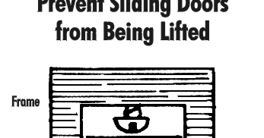
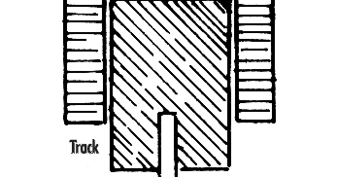
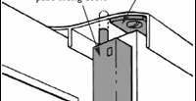
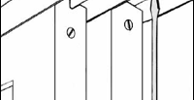
Arcadia/Sliding Glass Doors
Screw
In
upper
track
Some ways to secure them: Lift & Slide Protection
To deter this security issue,
slide the arcadia door open
and insert a pan/round head screw
in the upper track until the
door can shut completely.
Additional locking hardware
is available at most home
repair stores.

Slide 15
Arcadia/Sliding Glass Doors
Additional Options:
Thick dowel in
track.
B. Charlie Bar
C. Pins

Slide 16
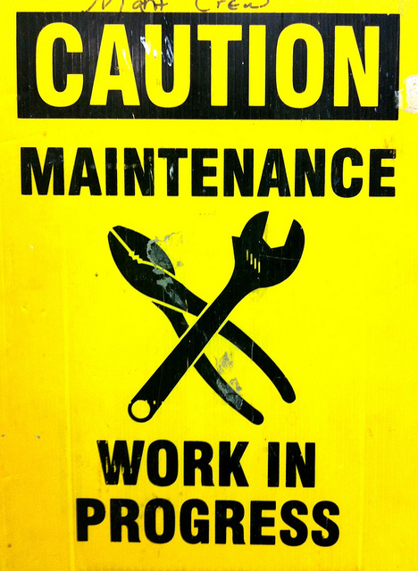
Maintenance

Slide 17
Maintenance
Ask, “What does the exterior of
the property say to a criminal?”.
Keep property well maintained
to send the “right” message.

