Slide 1
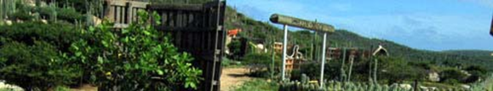
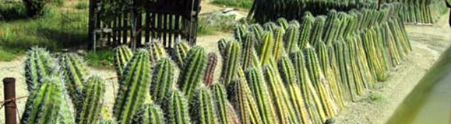
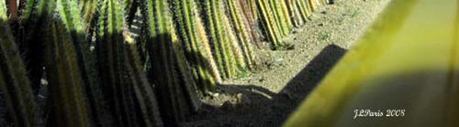
Access Control
Limits the number of entrances and exits on a property.
Is a method of guiding people to and from a space by the effective use of the entry‐ exit points to minimize uncontrolled movement.
Uses added barriers such as fencing, gates or landscape to control access on the property.

Slide 2
Natural Surveillance
The ability of the intended property users to “see and be seen”. To naturally observe their surroundings.
Creates, by uniquely designing buildings, activity locations (clubhouse, pool, laundry room, youth tot lot etc.) and landscape features to provide maximum visibility.
A concept based on the fact that criminals do not want to be observed.

Slide 3
Activity Support
Placement of any activity where the individuals there become a part of the natural surrounding, “surveillance”.
When the activity can be enjoyed safely, crime is deterred.
The “risk” for the potential offender increases. (They can be seen and identified)

Slide 4
Maintenance
If a rental property is well maintained, it shows management, or the owner, cares for and will defend the property against crime.
A property that is not maintained may indicate that the management is not concerned about the property, and might overlook or ignore criminal activity.

Slide 5
Ask Yourself:
How can I make the area unfriendly to unfriendly people?
How can I make it more friendly to the friendly people?
Is the area used for the intended purpose?

Slide 6
Broken Window Theory:
James Q. Wilson and George Kelling developed the `broken windows' thesis to explain the signaling function of neighborhood characteristics. This thesis suggests that the following sequence of events can be expected in deteriorating neighborhoods. Evidence of decay (accumulated trash, broken windows, deteriorated building exteriors) remains in the neighborhood for a reasonably long period of time. People who live and work in the area feel more vulnerable and begin to withdraw. They become less willing to intervene to maintain public order (for example, to attempt to break up groups of rowdy teens loitering on street corners) or to address physical signs of deterioration.
Sensing this, teens and other possible offenders become bolder and intensify their harassment and vandalism. Residents become yet more fearful and withdraw further from community involvement and upkeep. This atmosphere then attracts offenders from outside the area, who sense that it has become a vulnerable and less risky site for crime. The "broken window" theory suggests that neighborhood order strategies such as those listed on the next page help to deter and reduce crime.

Slide 7
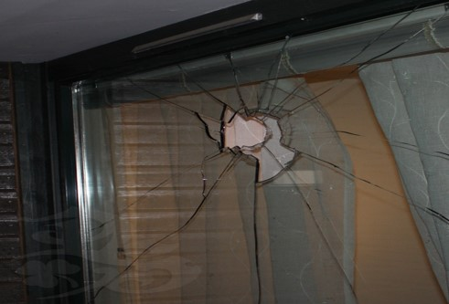
Broken Window Theory
Decrease the unrepaired
physical deterioration.
Increase concern for personal
well-being & safety.
Involve more fully the resident participation
in local events.
Prevent further increase in the deterioration
process of the community by detering increases in vandalism, disorderly behavior, rowdiness and increased delinquency among the residents.

Slide 8
Using C.P.T.E.D. to Landscape
Crime Prevention Considerations for Landscaping and Lighting…..
Before you Landscape consider the natural terrain:
Maximize the ability to see and be seen.
Define private space and separate it from public space.
Control access points onto and within the property.

Slide 9
Using C.P.T.E.D. to Landscape
Consider any conflicts…
Will the landscaping cause conflict with people?
Will it cause conflict with good activity or allow for bad activity?
Will it reduce the ability to see or be seen?
Will the landscaping interfere with lighting?

Slide 10
Using C.P.T.E.D. to Landscape
Plant Placement…
Protect/defend vulnerable areas with a thorny plant under a window (i.e., bougainvillea)
Consider plant size at maturity:
-Will it interfere with visibility? Big, bushy shrubs
Create hiding places and block views.
-Will it interfere with lighting? Trees are often planted next to light poles and, at maturity, the tree blocks the light, creating a shadowy or dark area.
Look at the following slides to see what we mean.

Slide 11

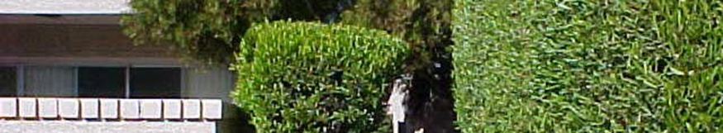
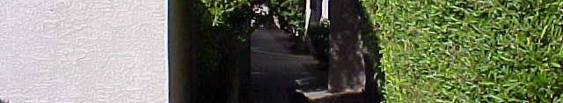
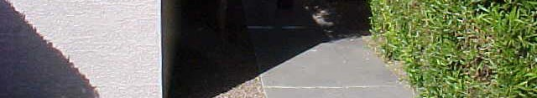
Landscaping
Overgrown vegetation invites crime!
Creates dark, shaded areas!
Reduces visibility!
Look how dark this space is during daylight, imagine how dark it will be at night!

Slide 12
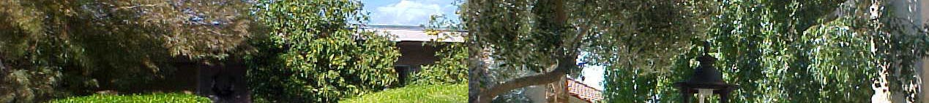
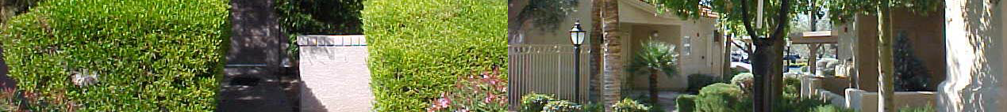
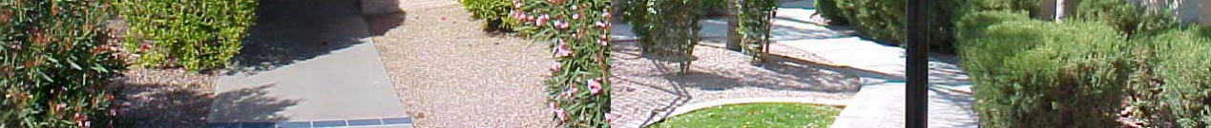
Landscaping
Poor Landscaping
Good Landscaping

Slide 13
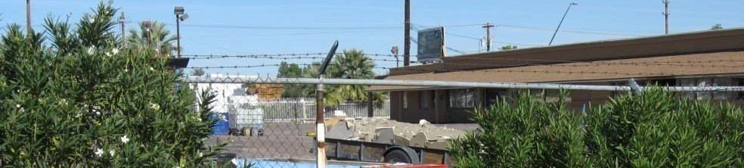
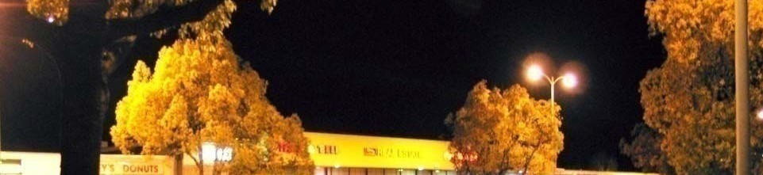
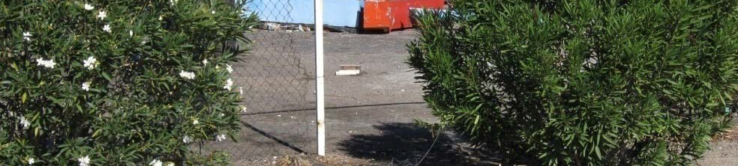
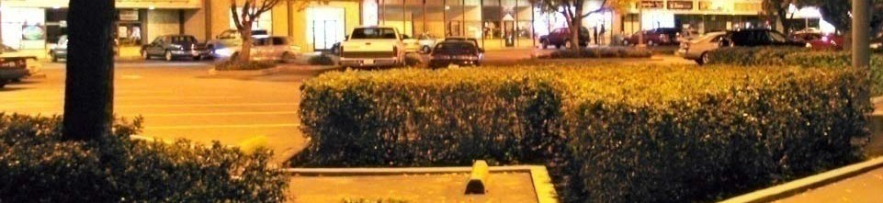
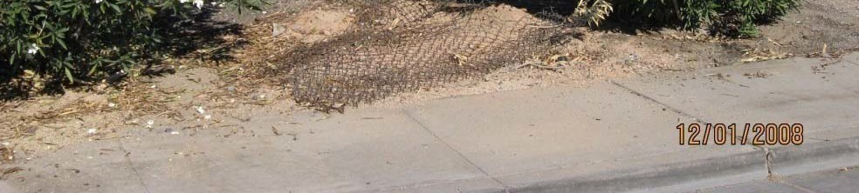
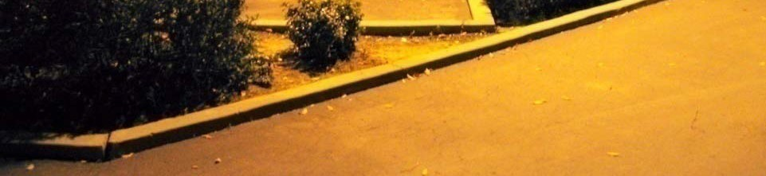
Landscaping
Poor Landscaping
Good Landscaping

Slide 14
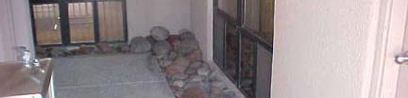
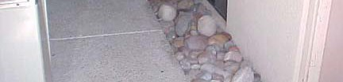
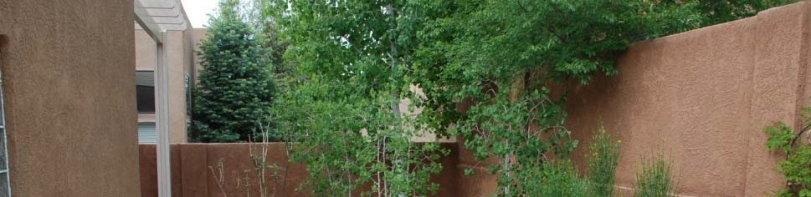

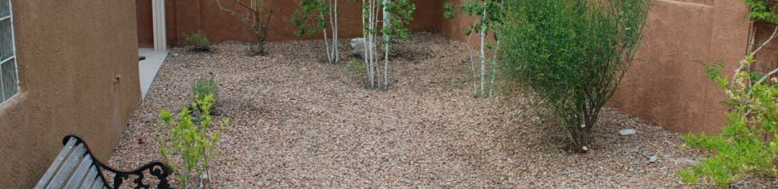
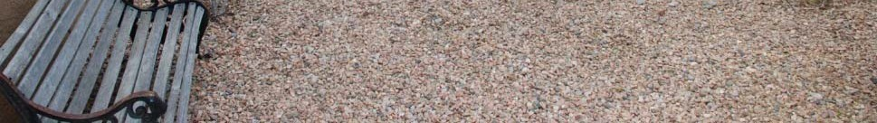
Landscaping
River Rock vs. Gravel
River rock can be used as a burglary tool.
Remove river rock from areas with glass windows and doors.
Smaller gravel is a crime deterrent.
It crunches when walked on.

Slide 15
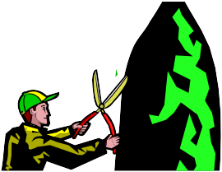
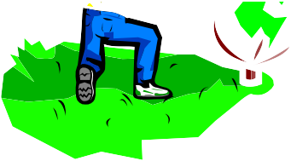
Don’t forget about plant maintenance!
As you saw on the previous slides, maintenance
of the landscaping is important to the overall
look of the property.
Maintain a 3’ to 7’ window of visibility!
Trim trees up to 7 feet from the ground and shrubs down to 3 feet maximum height.
All shrubs should be kept trimmed 6” below all window lines.
Don’t allow plants to become hiding places.
Well maintained landscaping sends the message that you respect your property and expect others to respect it also.

Slide 16
Target Hardening….
Locks
Programs
Lighting
Making the property safer….

Slide 17

Target Hardening
Crime Factors…
              TARGET
DESIRE OPPORTUNITY
Take away any one of these elements and a crime cannot occur. You can help reduce crime by taking away the opportunity for crime to occur!

