Slide 1
AgreeDB- Agreement Database Training

Slide 2
Overview
What is this?
Why are we doing it?
Quick Definitions
Generating Departments Responsibilities
Agreements Routing Process
AgreeDB Features
AgreeDB System Tour
Agreements Transmittal Form
What are the next steps?

Slide 3
What is it?
AgreeDB
A web-based application that gives a snapshot about agreement details, notifies agreement owners about key agreement dates, and generates reports to management for review.
Key Dates that occur after the execution of an agreement
Entering agreements from this point on
When possible entering original agreements
AgreeDB is a database, not a repository.
Version 1 of what will likely be a multiphase system.
Version 1 will have selective access to AgreeDB System.
Agreements Transmittal Form will affect everyone

Slide 4
Why?
Institutional Knowledge → AgreeDB
Digitally captures all agreements’ key data in a summary format
Key elements: expiration dates, tasks, agreement milestones
Resource for key data within a snapshot view for the organization
General Information
Business continuity
Ensure compliance by organizing all required follow-up
Follow-up is named “tasks” within the system
Serves as a reminder about upcoming deadlines through notifications
Enhances agreement management tools
Tracks key information for the lifespan of the agreement
Provides information regarding ownership and task assignees
Generates reports

Slide 5
Quick Definitions
Agreements:
Referencing contracts, agreements, grant awards, etc.; treated in the same manner but strictly referenced as Agreements to avoid confusion.
Generating Department:
Department that is initiating an agreement or receiving it from an outside agency.
Agreement Owner:
A person within the generating department that is responsible for the agreement through its lifespan and completion of agreement tasks (regardless of task assignee)
Supplementary Documents:
Documents related to an original agreement: Amendments, Addendums, Task Orders, Change Orders.
Task Assignee:
Potentially different than Agreement Owner. Tasks can be delegated to another person, but agreement owner is still responsible for agreement compliance. Task Assignees must be from the same generating department.

Slide 6
Generating Department’s
Responsibilities
Generating Department will
Ensure Agreements meet the appropriate workflow and approval process.
Fill out the Agreement Transmittal form with all available information.
Seek information before submitting it.
Be responsible for the agreements throughout its lifespan.
Follow the two step process any time an Agreement Owner is changed.
Other Departments:
Legal reviews agreements as necessary, provides legal advice and/or interpretation of agreement content, and may assist in filling out the Agreements Transmittal.
Legal is not responsible for completing and turning in the form or tasked with agreement compliance throughout its lifespan.
Procurement assists with procurement process before the execution of an agreement as necessary. Procurement will assist in filling out the Agreements Transmittal and turn it into Finance on behalf of the Agreement Owner.
Procurement is not the agreement owner and is not responsible for assigned tasks associated with the agreement or supplementary form throughout its lifespan.

Slide 7
Routing Requirements:
The focus is on integrating AgreeDB into workflow, this should not substantial change in terms of workflow prior to an agreement’s execution.
All Agreements:
Departments that initiate agreements are responsible for the workflow, status, and document submission to the Town Clerk Office or Finance Department for AgreeDB and Laserfiche to ensure the agreement has properly been recorded and is properly being tracked.
Need department, finance, management approval as required for specific agreement in order to initiate the agreement process.
Agreement shall be reviewed by the legal department; timing is dependent upon the individual agreement.
Must follow town procurement policies including but not limited to the $2,500, $25,000 thresholds.
Agreements Transmittal Form will be routed together with the agreement or supplementary document.

Slide 8
Routing Mechanisms:
Interdepartmental Routing Process (includes receipt of IGAs & MOUs):
Department must ensure all proper documents and signatures are completed.
Agreement Owner must turn in Agreement Transmittal Form to the Town Clerk’s Office or Finance with the original or copy of the agreement.
Current Process:
Finance if it is financial nature
All others to the Town Clerk’s Office
Agreement Owner must submit additional Agreements Transmittal forms for each change to the Agreements (Amendments/Addendums, Task Orders, or Change Orders).

Slide 9
Routing Mechanisms:
Finance’s Procurement Routing Processes:
Procurement is responsible for determining the agreement procurement method (i.e. RFP/RFB, JOC, Cooperative (Linking) Agreement)
Finance’s procurement officer will be responsible for the workflow of selection, administering and closing procurements and agreements.
Procurement will assist in filling out the Agreements Transmittal and turn it into Finance on behalf of the Agreement Owner.
Agreement Owner must work with the Procurement Office when submitting additional Agreements Transmittal Forms for each change to the Agreement (Amendments/Addendums, Task Orders, or Change Orders).

Slide 10
Routing Mechanisms:
Town Council Approval Process:
After following the Internal or Finance routing methods, the generating department is required to submit Agreements Transmittal Form into AgendaQuick for Council consideration.
The Generating Department will upload the document into AgendaQuick, under the Resource section as an Attachment.
Number the Attachment Agreement Transmittal #Zero (0) (numerical value)
Must attach a physical copy of the Agreements Transmittal form to the physical agreement documents that Towns Clerk Office will be signing.
Agreement Owner must submit additional Agreements Transmittal forms for each change to the Agreements (Amendments/Addendums, Task Orders, or Change Orders).

Slide 11
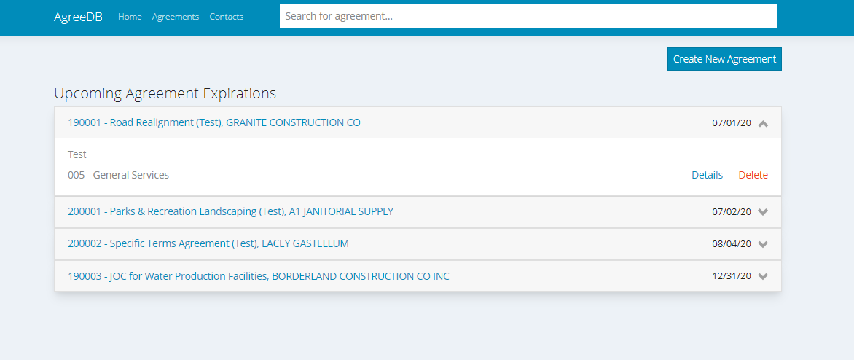
AgreeDB System Tour

Slide 12
AgreeDB System Tour

Slide 13
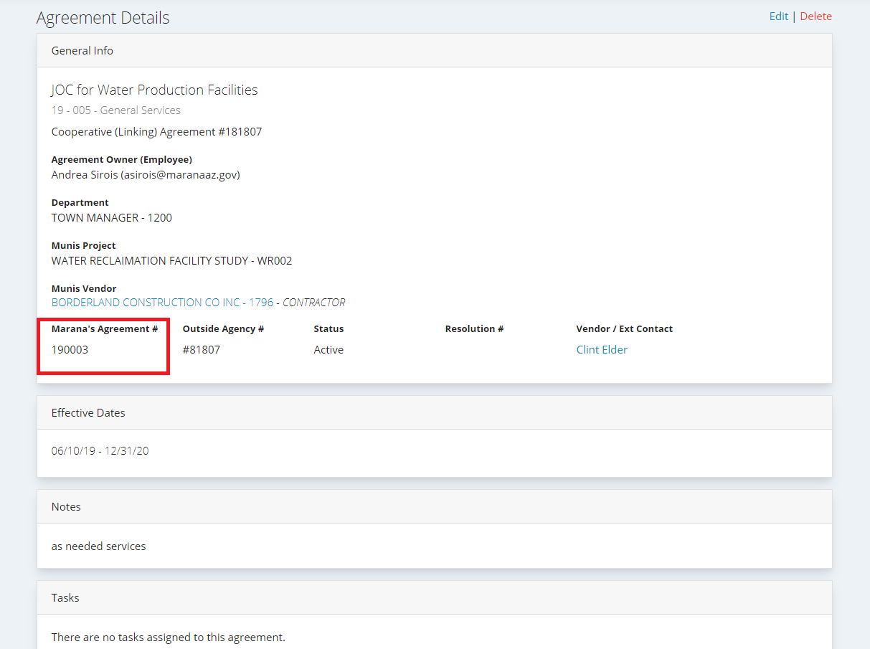
AgreeDB System Tour

Slide 14
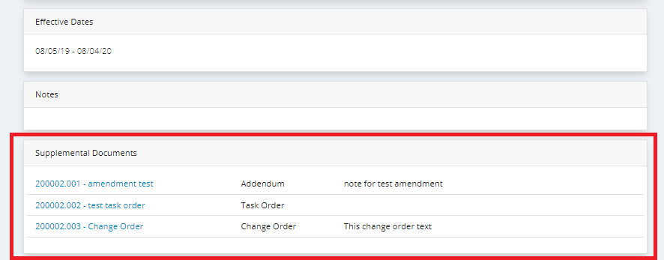
AgreeDB System Tour

Slide 15
AgreeDB System Tour

Slide 16
AgreeDB Management Tool
Manager Reports
Will be sent to Finance and Town Clerk’s Office then distributed to the relevant Department Heads at the beginning of every month.
Reports include
Renewal (Upcoming)
Tasks (Past Due and Upcoming)
Tasks will show past due tasks are not completed or email was not contacted at the completion of a task

Slide 17
AgreeDB Notifications
Task Notifications
Task Types:
Renewals, Bonds, Certificates of Insurance, Payments, General Compliance (debt issuance, required reports)
Task assignee may be different than agreement owner.
Department assistants are never to be agreement owners.
Task Notifications:
Meeting invite in Outlook set at 7am
120, 90, 60, 30 day upcoming notification settings (up to 5 notifications total including deadline date)
Must email Finance or Town Clerk’s Office after the completion of the task.
If not, it will be considered past due on manager’s reports.

Slide 18
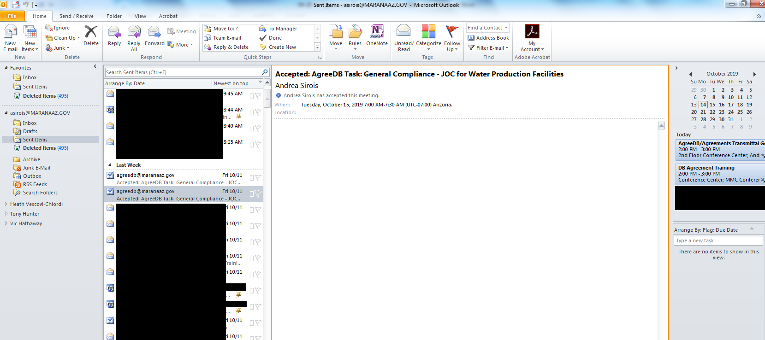
AgreeDB Outlook Notifications

Slide 19
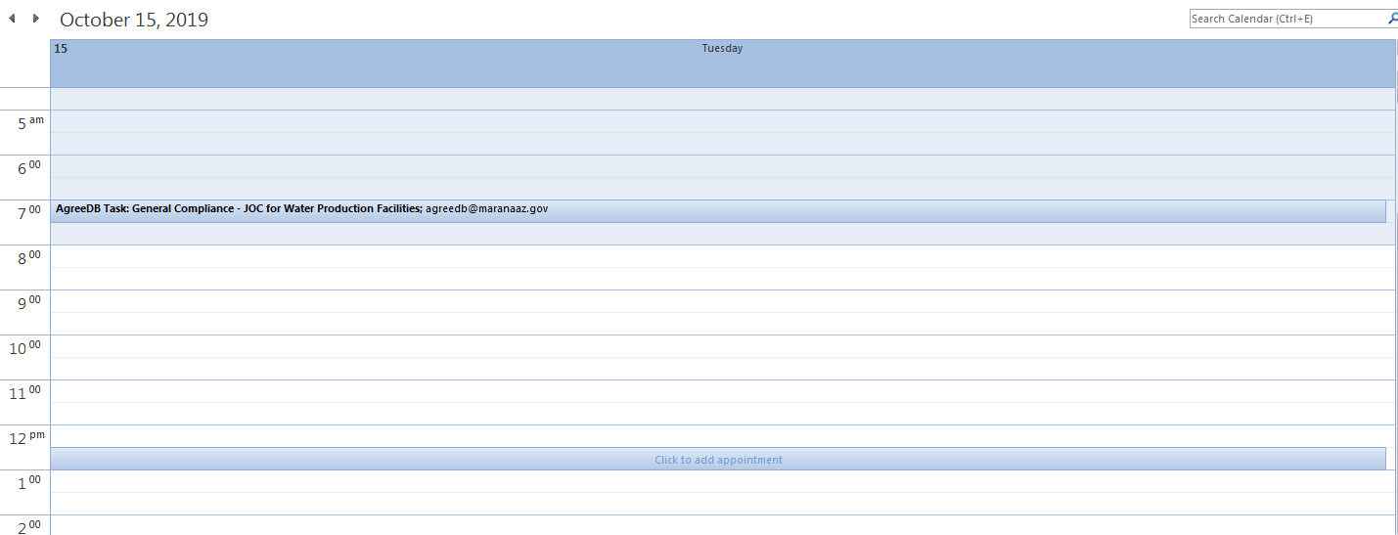
AgreeDB Outlook Notifications

Slide 20
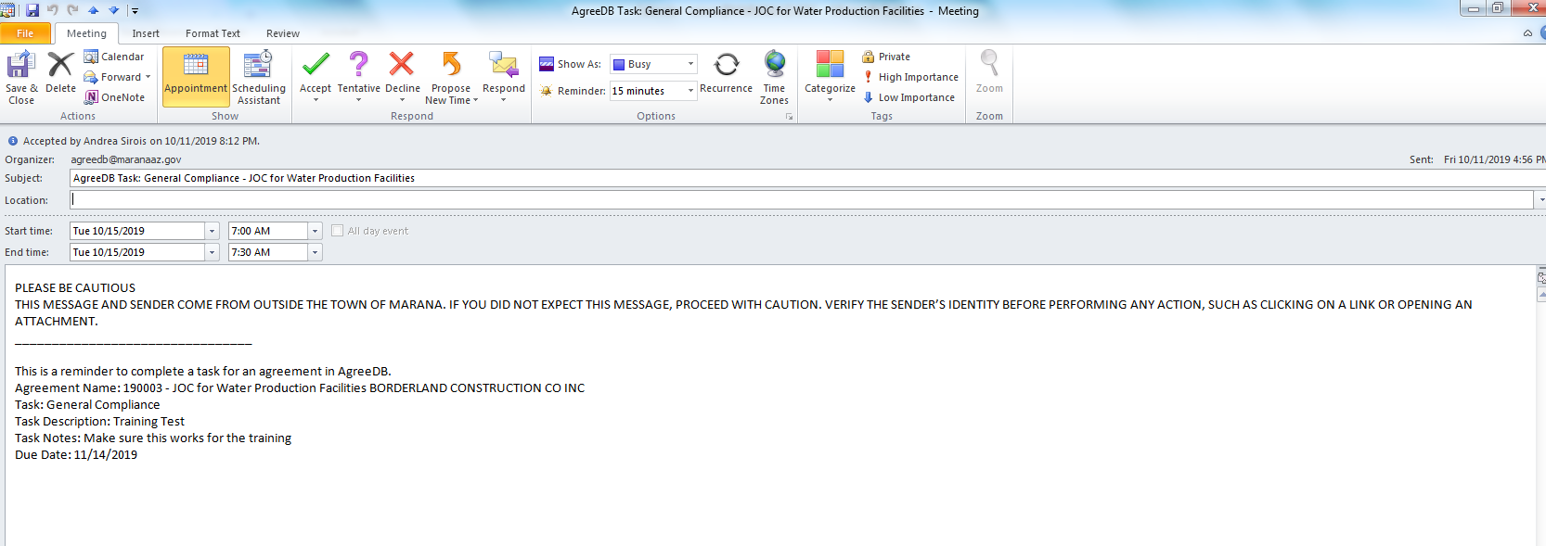
AgreeDB Outlook Notifications

Slide 21
Agreements Transmittal Form
Purpose
Agreements Transmittal Form is intended to collect information for Laserfiche and AgreeDB. This is to avoid duplication of forms.
Sections
Basic Agreement Information
AgreeDB Tasks and Notifications
Laserfiche Details/Other Details
Finance/Town Clerk’s Office Internal
Document References
Notes
For V1 it is a paper or digital fillable PDF sheet that is sent to Finance or Town Clerk’s Office by the Agreement Owner.

Slide 22
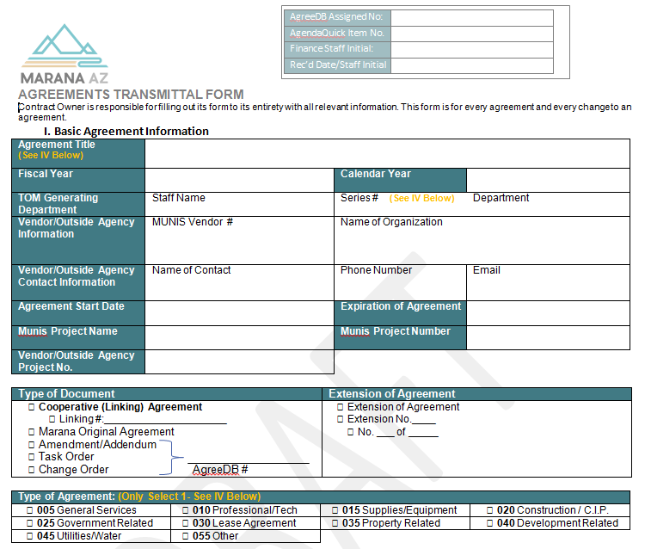
Agreement Transmittal Form

Slide 23
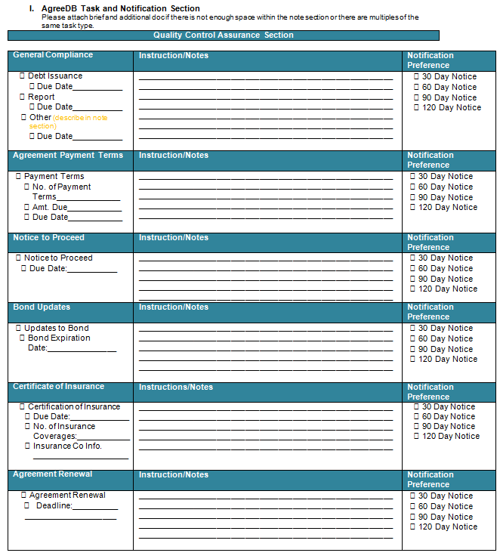
Agreement Transmittal Form

Slide 24
Agreement Example
Handed out agreements to fill out an Agreements Transmittal Form

Slide 25
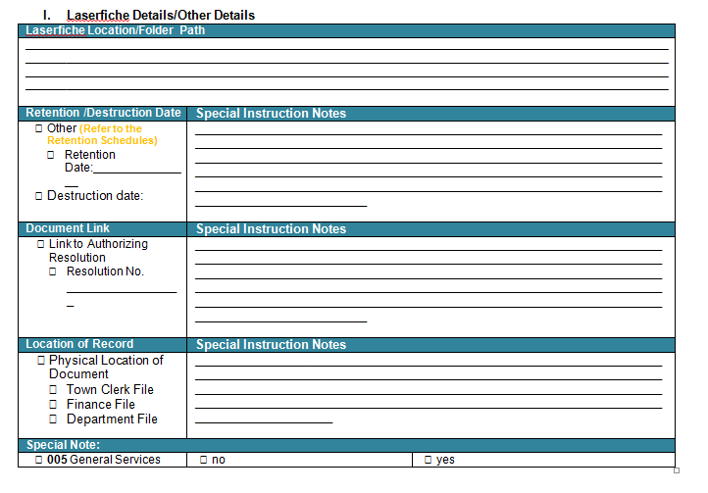
Laserfiche Instructions
Opportunity for agreement owners to provide Town Clerk’s Office relevant information.

Slide 26
What’s Next?
Review Procedures and Agreements Transmittal
App Launch: Oct 18th @5pm
All staff are required to fill-out Agreements Transmittal Form for each agreement or supplementary document.
Designated users will have either editing or viewable access within AgreeDB.
Email Yiannis and Erik to request viewing access and the access lists will be reviewed periodically.

Slide 27
For Additional Questions
Contact
Lucinda Norris
Finance Department
lnorris@maranaaz.gov
X1942
Suzanne Sutherland
Town Clerk’s Office
ssutherland@maranaz.gov
X1961

